Slide 1

WALMART SALES ANALYSIS

Slide 2

OBJECTIVE
The objective of Walmart sales analysis is to examine and understand the performance and trends of sales in Walmart stores. It involves gathering, analyzing, and interpreting data related to sales to gain insights and make informed decisions. The ultimate goal is to use these insights to make data-driven decisions.

Slide 3
ABSTRACT
The Analysis might help the organization to improve their performance and improve their profit. It starts with data collection from stores. And the insights derived from them can help them to data driven decision. It provide insights by analyzing sales data, utilizing statistical analysis, data visualization. And analysis depends on the quality of the data. Which makes the analysis team to give better information and insights.

Slide 4

INTRODUCTION
The project is about walmart sales report, the attributes which we used are order id, order date, ship date, customer name, country, city, state, category, product name, sales, quantity, profit.
Which consists of 3200 data's related to walmart sales report.
By using this data we proceed data visualization to create interactive dashboard.

Slide 5
DATA FLOW DIAGRAM
Collect dataset
Process the dataset
Analyse the dataset
Visualize the dataset
Prepare insights

Slide 6
LITERATURE SURVEY
S.NO | AUTHOR | YEAR OF PUBLISH | JOURNAL | REMARKS
1 | "Sales Analysis and Performance Evaluation in Retail: A Case Study of Walmart" | 2018 | Journal of Retail Analytics | study explores the sales analysis practices at Walmart and their impact on performance evaluation
2 | "Data Analytics for Sales Optimization in Retail: A Study of Walmart's Data-driven Approach" | 2019 | International Conference on Data Analytics and Business Intelligence | This research paper explores how Walmart utilizes data analytics techniques for sales optimization.

Slide 7
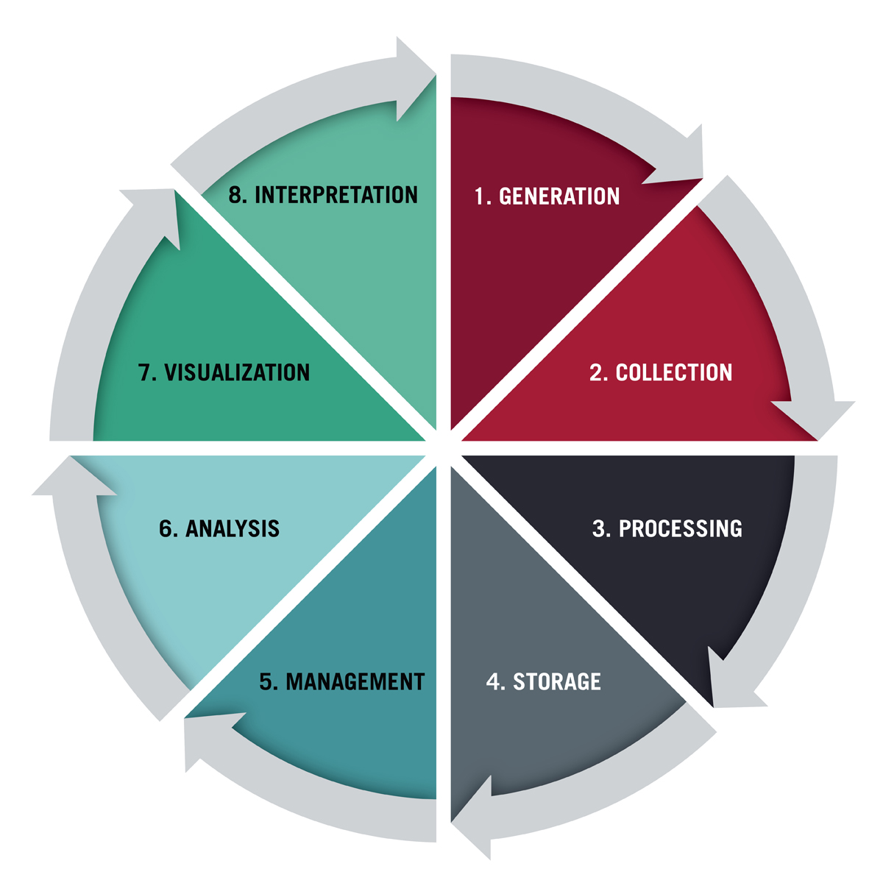
LIFE CYCLE OF DATA ANALYTICS

Slide 8


MODULE SPLITUP
Data Collection and Processing
Data visualization
Machine Learning

Slide 9
DATA COLLECTION & CLEANING:
For data collection we need to specify the requirements needed for the analysis.
Then the data can be generated. Not all the generated data are collected it depends on data team. It can be generated through social medias, google forms etc...
Then the required data are collected and stored in clouds as a database.
Then the collected data are processed which is known is data cleaning.
Where all the errors, blank spaces, duplicate data, empty spaces are removed.

Slide 10
DATA VISUALIZATION:
Data visualization is nothing but visual representation of the collected data which makes easy to understand.
We use Power BI to represent the data in the form of graph, pie charts, cards, tables etc... to represent the data.

Slide 11
MACHINE LEARNING
LINEAR REGRESSION
Linear regression is a statistical modeling technique used to establish a relationship between a dependent variable and one or more independent variables.
Variable used are:
SALES
DISCOUNT
PROFIT

Slide 12
LINEAR REGRESSION
Step 1-Import Library
PANDAS
SKLEARN-LINEAR MODEL
MATPLOTLIB
Step2-Load the csv file
Step3-load csv to dataset
Step4-summarise dataset
Step5-Visualize dataset

Slide 13
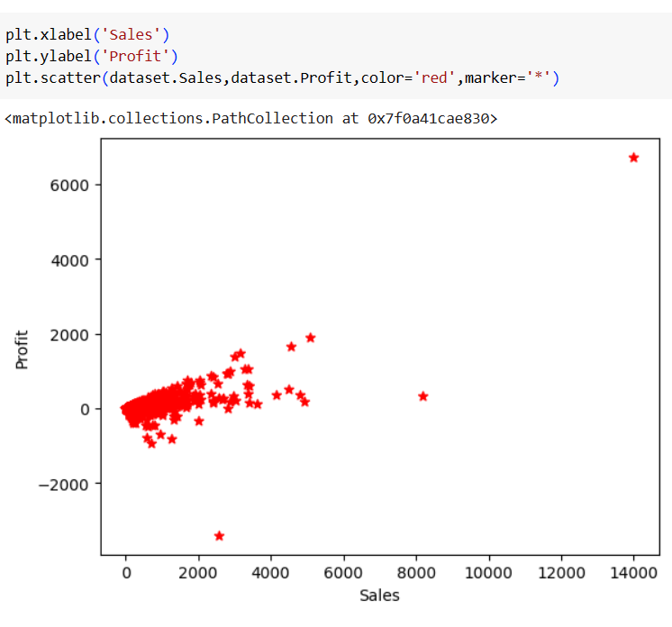
Graph between Profit and Sales

Slide 14
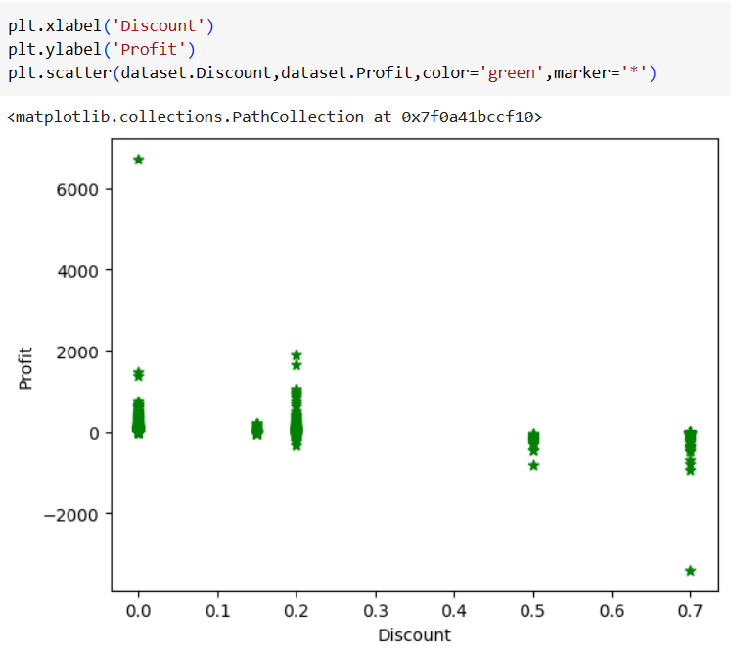
Graph between Profit and Discount

Slide 15
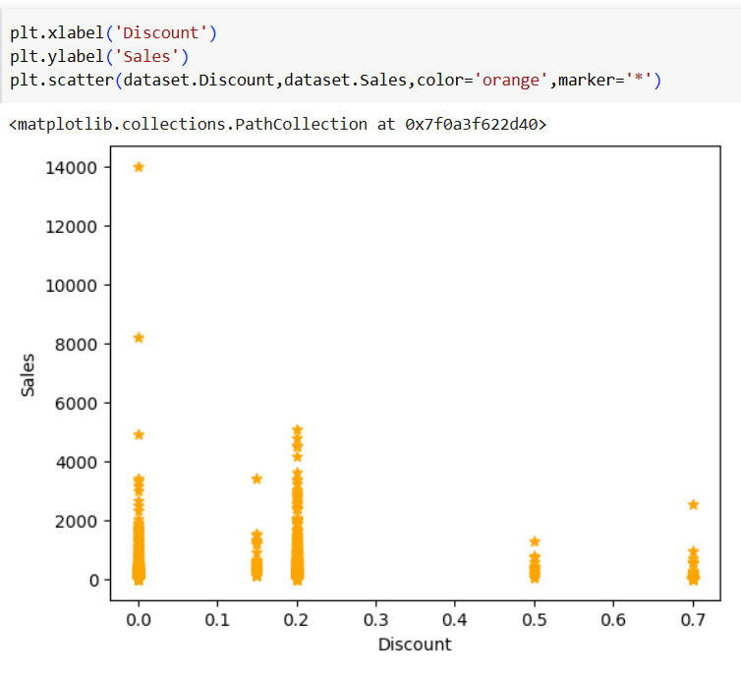
Graph between Sales and Discount

Slide 16
FUTURE ENHANCE
As Walmart continues to expand its online presence and implement omni-channel strategies, integrating data from various channels becomes crucial for comprehensive sales analysis.
Walmart can improve its sales analysis by implementing advanced data visualization techniques.
Walmart can augment its sales analysis by incorporating external data sources into its analysis. This includes leveraging data from third-party providers, market research firms, social media platforms, and economic indicators.
Walmart can further enhance its sales analysis by adopting advanced predictive analytics techniques.

Slide 17
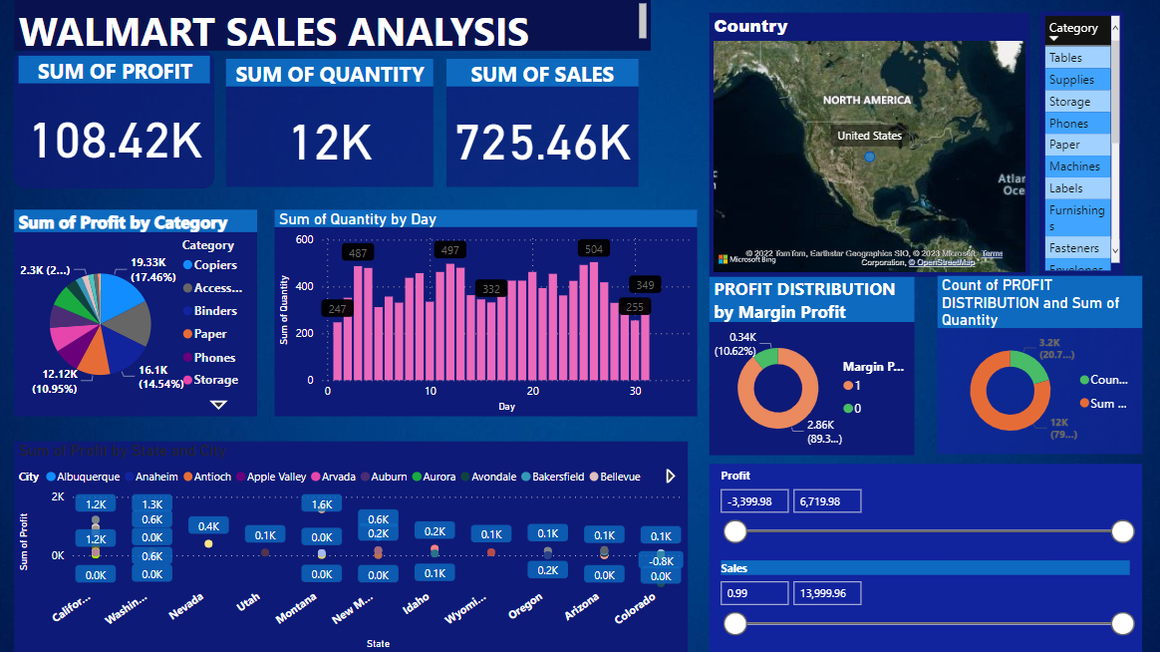

Slide 18
CONCLUSION
Hence, from our analysis we found the total sum of sales which is 735.46K, and we found the sum of profit which is108.42k.
And we analyzed sum of profit by category, and we concluded that copiers are the category which gives more profit compared to others.
Hence by the conclusion we made the organization can make their sales better and which can increase their profit and also which helps to concentrate on other categories whether to improve the sales by reducing cost or by any other way or to remove that category of items from the list so that they can spend that money on other products which can increase the profit better and higher comparatively.

Slide 19
REFERENCES
[1]. Bakshi, C. (2020). Random forest regression. https : / / levelup . gitconnected . com / random-forestregression-209c0f354c84.
[2]. Bari, A., Chaouchi, M., & Jung, T. (n.d.). How to utilize linear regressions in predictive analytics. https://www.dummies.com/programming/big-data/data-science/ how-to-utilize-linear-regressions-inpredictive-analytics/.
[3]. Crown, M. (2016). Weekly sales forecasts using non-seasonal arima models. http : / / mxcrown.com/walmartsales-forecasting/.
[4]. Harsoor, A. S., & Patil, A. (2015). Forecast of sales of walmart store using big data applications. International Journal of Research in Engineering and Technology eIS, 04, 51–59. https : / / doi . org / https : / / ijret . org / volumes / 2015v04 / i06 / IJRET20150406008.pdf.

Slide 20

THANK YOU

